Slide 1




Comparison of Quantum Computing Algorithms for Mitigation of DDoS Attacks
Rian Dickman (Marist student researcher)
Casimer DeCusatis (Marist)
Cameron Cogburn (Rensselaer Polytechnic Institute)
1

Slide 2
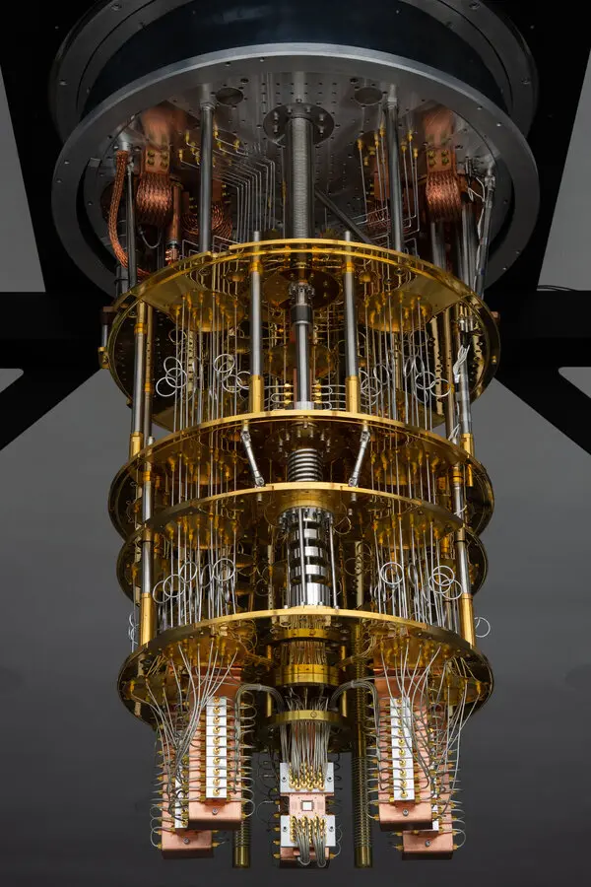
Agenda
Applying Quantum Algorithms: Max-Cut Equation
Mapping to quantum hardware architecture
QAOA/VQE implementation
Experimental Results
IMAGE
RPI
2

Slide 3
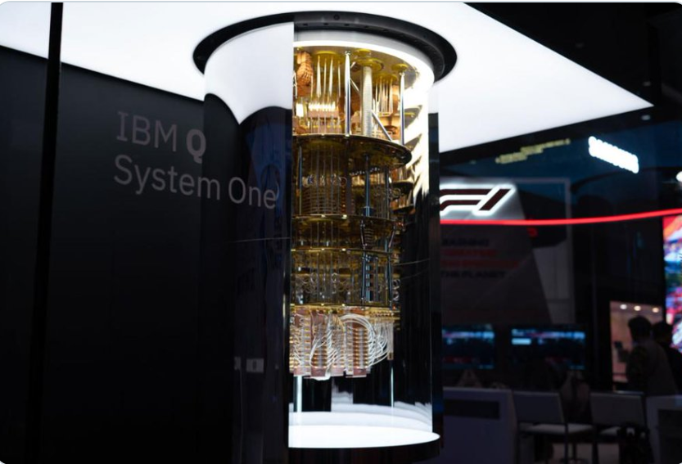
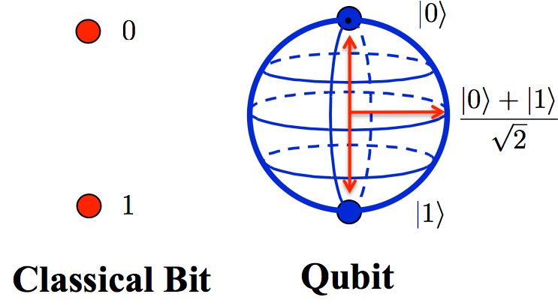
What is Quantum Computing
Classical computers use bits, which can be either a 1 or a 0, to store and manipulate information
Quantum Computers use quantum bits (qubits) which can be in a superposition, allowing a qubit to be in multiple states at once
RPI
3
Notes:
Just to give you guys a brief overview of what quantum computers are and what separates them from classical computers…
Quantum computers use qubits, which can represent 0 and 1 at the same time. You can think of it like a spinning coin.
N qubits is the equivalent of 2^{N} classical bits. This means power increases exponentially in proportion to the number of qubits.
Quantum computing is well-suited for tasks like optimization problems, data analysis, and simulating chemical reactions.
What makes quantum computers so cool is that they can quickly solve problems that would take classical computers much longer. As the number of qubits increases and the computing power increases exponentially, the amount of time it takes to solve a problem drops off as an inversely related function​.

Slide 4
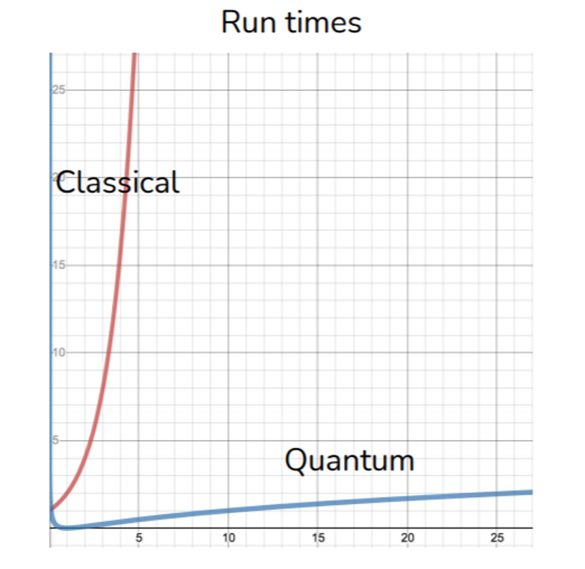
Scaling & Uses of Quantum Computing
N qubits is the equivalent of 2^{N} classical bits. This means power increases exponentially in proportion to the number of qubits.
Well-suited for tasks like optimization problems, data analysis, and simulating chemical reactions
RPI
4

Slide 5
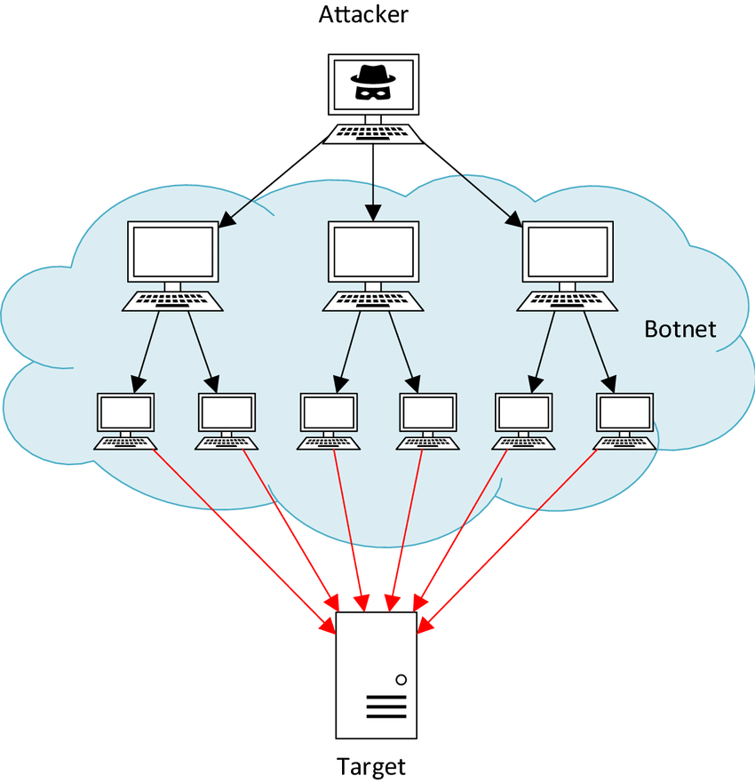
DoS and DDoS Attacks
Denial of Service (DoS) and Distributed DoS attacks flood a computer with network connection requests, forcing the computer offline
The largest attacks have traffic up to 1.7Tbps
The number of DDoS attacks is up 46% compared to this same period of last year
RPI
5
Notes:
That brings us to our problem today…

Slide 6
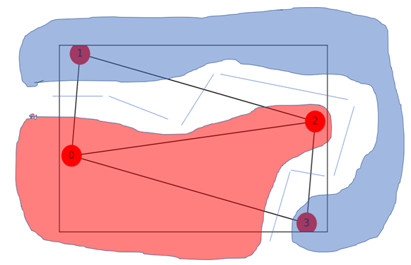
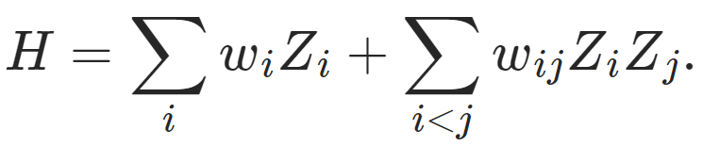
Applying Quantum Algorithms
We can use the maximum-cut equation to help the network firewall decide which connections to block or accept. The Max-Cut equation is an np-hard optimization problem that finds the partition in a graph that returns the maximum value
For application on a quantum computer, the max-cut equation is equivalent to minimizing the Ising Hamiltonian (below)
RPI
The solution found by the QC can be used to stop an ongoing attack.
6

Slide 7
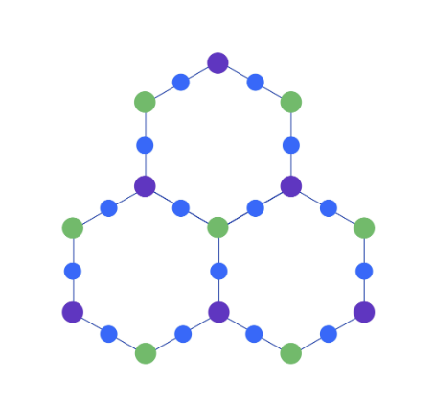
Quantum Computer Architecture
Mapping Problems to the Heavy Hex Design
Each unit cell consists of a hexagonal arrangement of qubits, with an additional qubit on each edge
Some qubits have 3 neighbors, some only have 2
Swap gates can access qubits that are further away, but these introduce noise
Nearest neighbor problems that don’t require swap gates map best to this architecture
We represent our problem and observables as a decomposition into sparse Pauli operators (and their tensor products).
Variational optimizers such as QAOA, VQE may also be expressed as spin Hamiltonians which map well to a heavy hex architecture
Three unit cells of the heavy-hex lattice. Colors indicate the pattern of three distinct frequencies for control (dark blue) and two sets of target qubits (green and purple)
RPI
7
Notes:
https://www.ibm.com/quantum/blog/heavy-hex-lattice

Slide 8
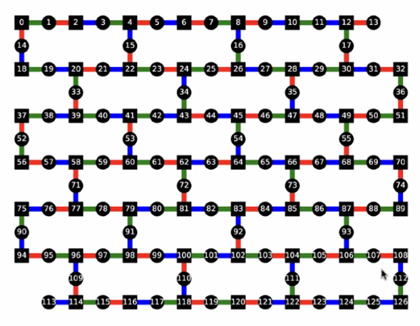
Quantum Computer Architecture
Mapping Problems to the Heavy Hex Design
Each unit cell consists of a hexagonal arrangement of qubits, with an additional qubit on each edge
Some qubits have 3 neighbors, some only have 2
Swap gates can access qubits that are further away, but these introduce noise
Nearest neighbor problems that don’t require swap gates map best to this architecture
We represent our problem and observables as a decomposition into sparse Pauli operators (and their tensor products).
Variational optimizers such as QAOA, VQE may also be expressed as spin Hamiltonians which map well to a heavy hex architecture
Three unit cells of the heavy-hex lattice. Colors indicate the pattern of three distinct frequencies for control (dark blue) and two sets of target qubits (green and purple)
RPI
Visualization of the 127 qubit heavy hex lattice (false colors indicate 3 layers of controlled Z-gates and nodes with vertex connectivity
8
Notes:
https://www.ibm.com/quantum/blog/heavy-hex-lattice

Slide 9
127 Qubit Heavy Hex Design
Visualization of the Heavy Hex layout of the current 127 qubit RPI quantum computer
Red, Green, Blue links correspond to the 3 layers of controlled Z-gates
Within each layer, gates can be executed in parallel
Shape of the nodes (round, square) corresponds to a vertex of the graph
RPI
9
Notes:
Colin Kai-Uwe Becker, “Benchmarking multipartitie entanglement generation with graph states”, Advanced Quantum Technology vol 8 no 1 (October 2024)

Slide 10
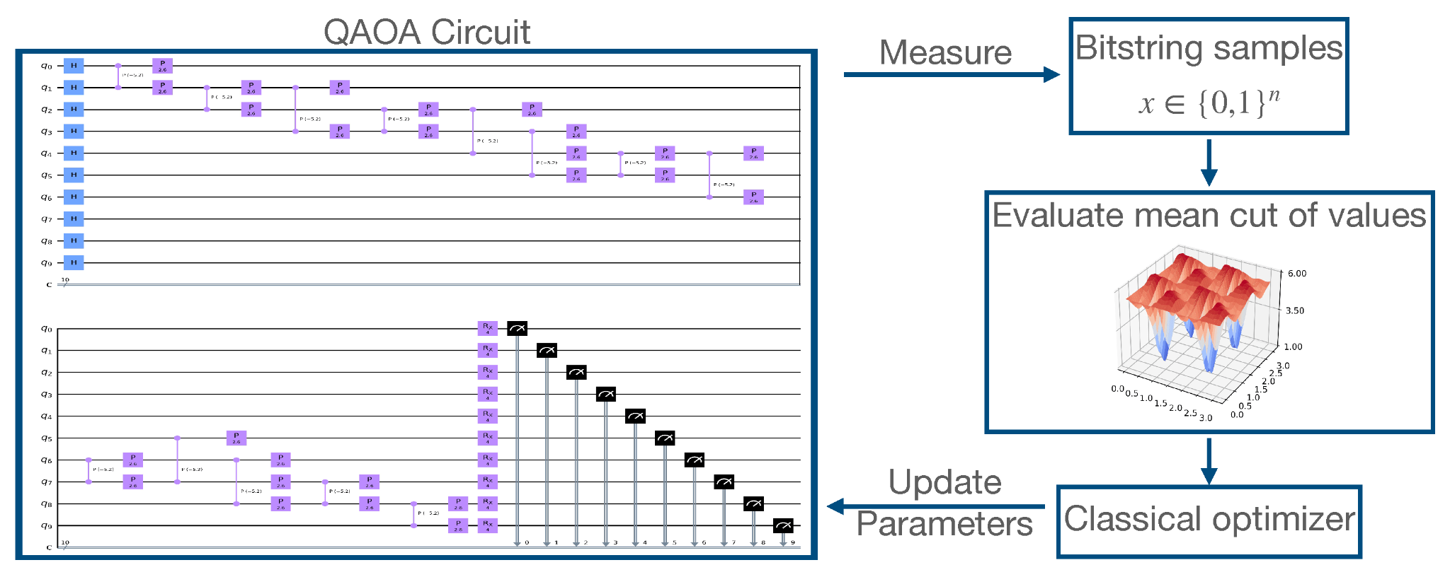
Quantum Approximate Optimization Algorithm (QAOA)
QAOA is general technique that can be used to find approximate solutions to combinatorial optimization problems, in particular problems that can be cast as searching for an optimal bitstring.
Expected to obtain better approximate solutions
Samples the circuit to approximate solutions to the optimization problem
RPI
10
Notes:
The Quantum Approximate Optimization Algorithm (QAOA), a hybrid quantum-classical algorithm, is expected to obtain better approximate solutions than any existing classical algorithms. QAOA utilizes a classical computer trains the parameters for quantum circuit. The parameterized quantum circuit approximates the adiabatic evolution from an initial Hamiltonian, whose ground energy state is easy to prepare, to a final Hamiltonian, whose ground energy state encodes the solution of the Max-Cut problem.

Slide 11
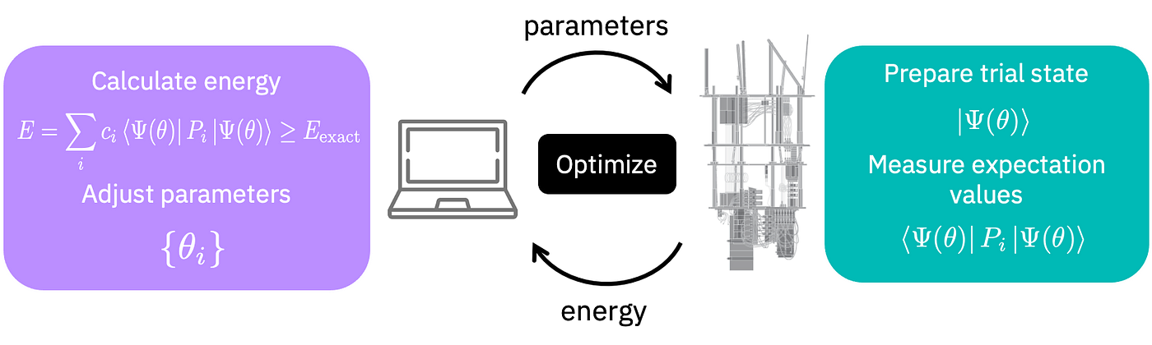
Variational Quantum Eigensolver (VQE)
Uses a variational technique to find the eigenvalue of a given Hamiltonian Operator
The quantum subroutine has two fundamental steps:
Prepare the quantum state |Ψ(vec(θ))⟩ (often called the ansatz).
Measure the expectation value ⟨Ψ(vec(θ))|H|Ψ(vec(θ))⟩
RPI
from Qiskit.org
11
Notes:
VQE is a hybrid quantum-classical algorithm that uses a variational technique to find the minimum eigenvalue of a given Hamiltonian operator.
The VQE algorithm is executed using an estimator primitive, which computes expectation values of operators (observables).
The inputs to the VQE algorithm are a molecular Hamiltonian and a parametrized circuit preparing the quantum state of the molecule. Within VQE, the cost function is defined as the expectation value of the Hamiltonian computed in the trial state. The ground state of the target Hamiltonian is obtained by performing an iterative minimization of the cost function. The optimization is carried out by a classical optimizer which leverages a quantum computer to evaluate the cost function and calculate its gradient at each optimization step.

Slide 12
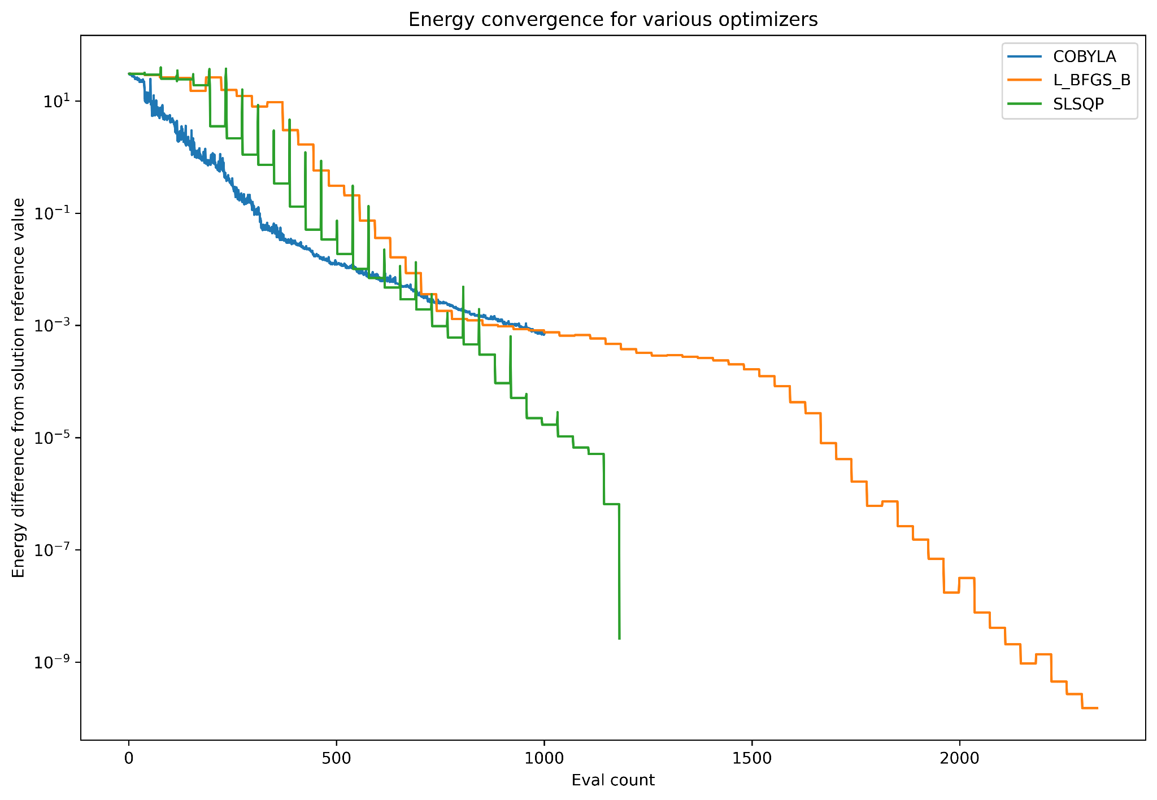
Classical Optimizers
The program uses a classical optimizer for the calculations in between runs on the quantum computer, and to sample results
COBYLA (Constrained Optimization by Linear Approximation) is the most effective out of the acceptable options for qiskit
RPI
12

Slide 13
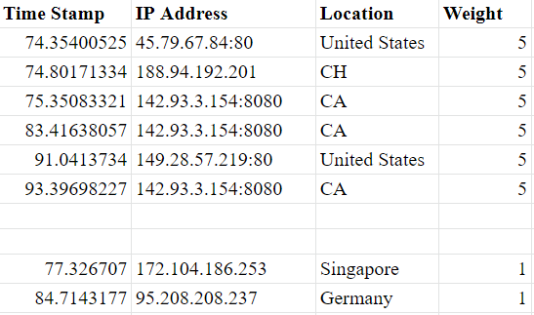
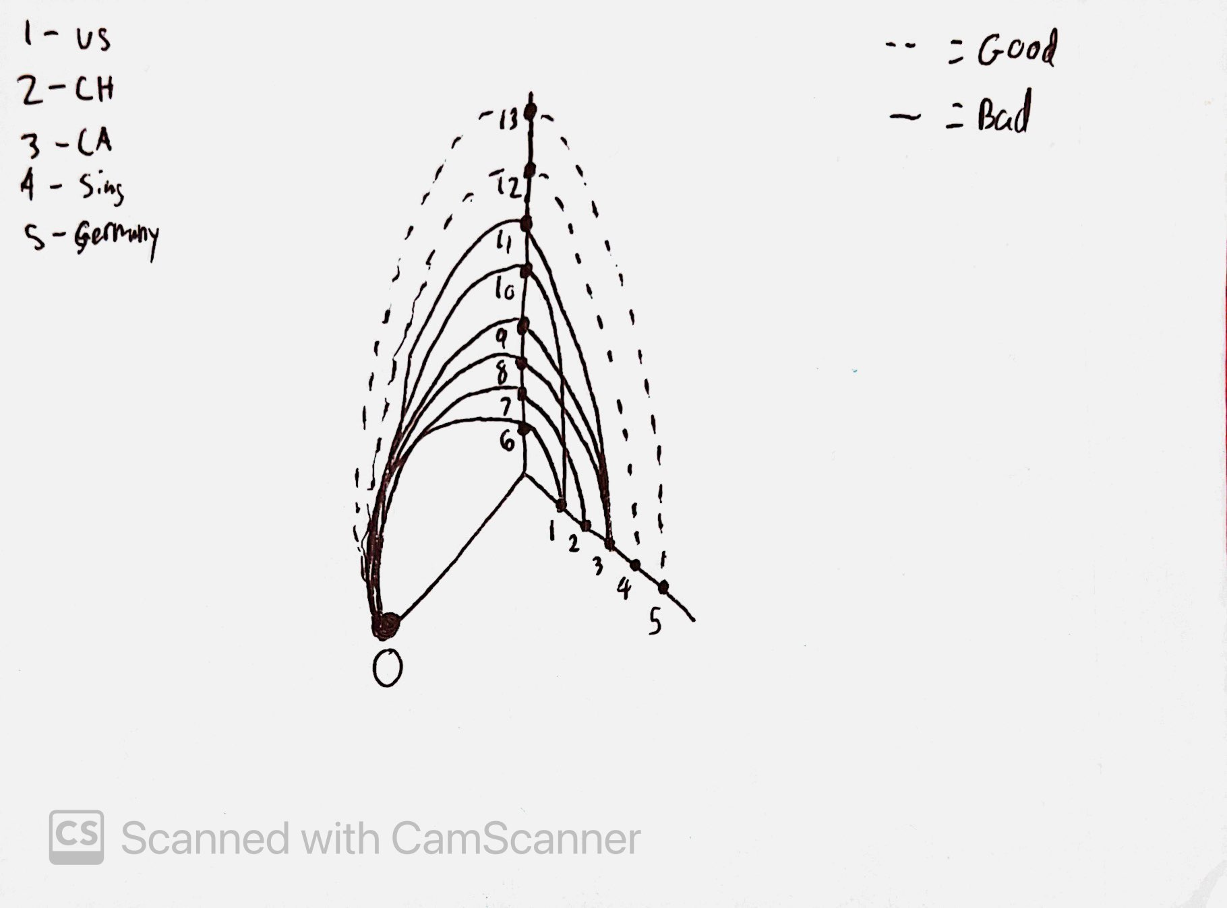
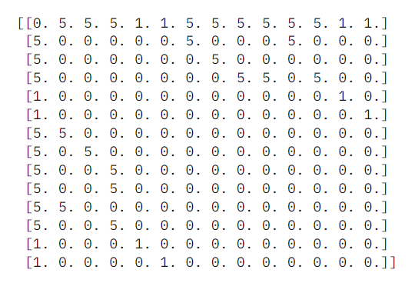
Data Sets: Honeynet to Hive Plot to Matrix
RPI
13
Notes:
Students at Marist previously developed a network of honeypots that are used to collect and analyze various cybersecurity attack patterns that affect the college. The datasets that we used for this project come from recorded attacks on our honeypots.
The College has collected data sets with over 2,000 samples showing both normal traffic and DDoS attacks spread out in intervals of 15 second windows
The raw data from these honeypots is stored in an Excel sheet that shows the time of the attack, the IP address, the location, and an arbitrary weight assignment. For malicious traffic this weight assignment is 5 and for all normal traffic this is 1.
From there, the data is turned into a hive plot, where 0 is the target node/our honeynet, the nodes on the horizontal axis are the countries of origin, and the nodes on the vertical axis are the time stamps for the network traffic/attacks. All nodes are connected based on the raw data with either a solid line representing malicious traffic or a dashed line representing normal traffic.
To input the data into IBM's Quantum Lab environment, we need it in a list format, so we created a matrix from the hive plots. The matrix is created to represent connections between every node combination. Nodes that aren’t connected receive a 0, nodes that are connected with normal traffic receive a 1, and nodes connected with malicious traffic receive a 5 or any other non-1 number.
While not all of these steps may be necessary, they help us to better visualize the data.

Slide 14
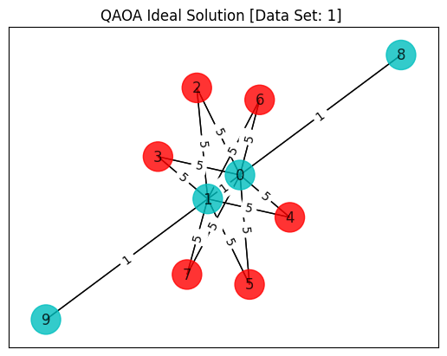
Diagram Breakdown
Weights are assigned to differentiate attack traffic from regular traffic
A weight of 1 represents a regular connection
A weight of >1 represents the connection is coming from an attacking node (a DoS or DDoS attack)
Network Nodes
Colors
The graph is partitioned, with one side of the cut being nodes of color X, and the other side of the cut being nodes of color Y
Colors used are Red and Cyan
In this example, Cyan nodes are regular traffic, and Red nodes DDoS traffic
Color X: One side of cut
Color Y: Other side of cut
RPI
Weight
14

Slide 15
Edge Weights
Importance
Assigning Weights
One of the most important factors of the algorithm is the weight of the edge (connection) between 2 nodes
This is how the equation decides how to partition the network
Weights are assigned based on likelihood to be an attacking connection.
Our SIEM, such as splunk, gathers data about incoming traffic
That data is combined with our own predetermined criteria that are set regarding connection location, timing, and the origin IP.
Possible implementation of random forest AI to help more accurately determine weights
RPI
15

Slide 16
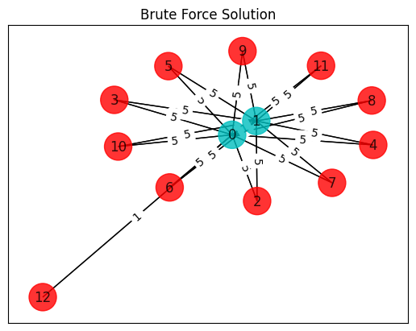
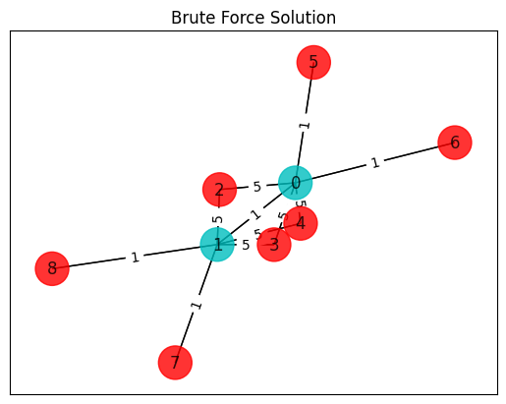
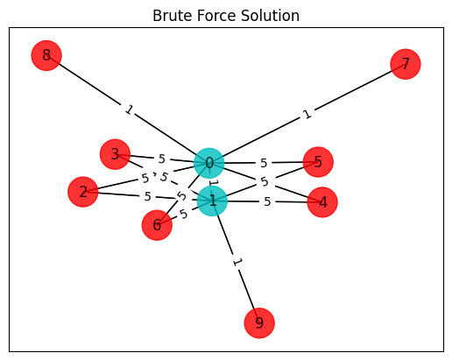
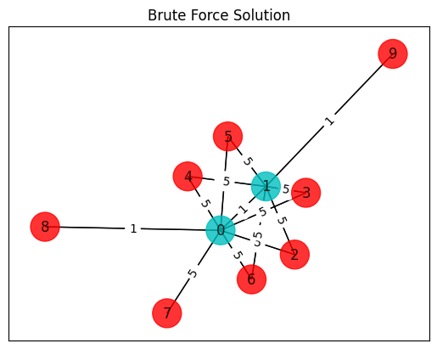
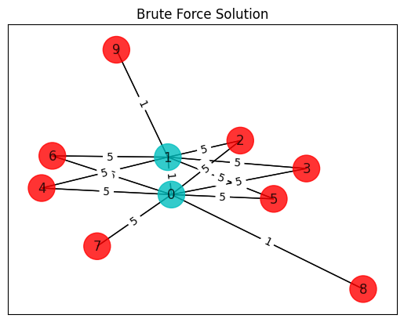
Data Sets (from paper)
P1
P2
P3
P4
P5
P6
RPI
16

Slide 17
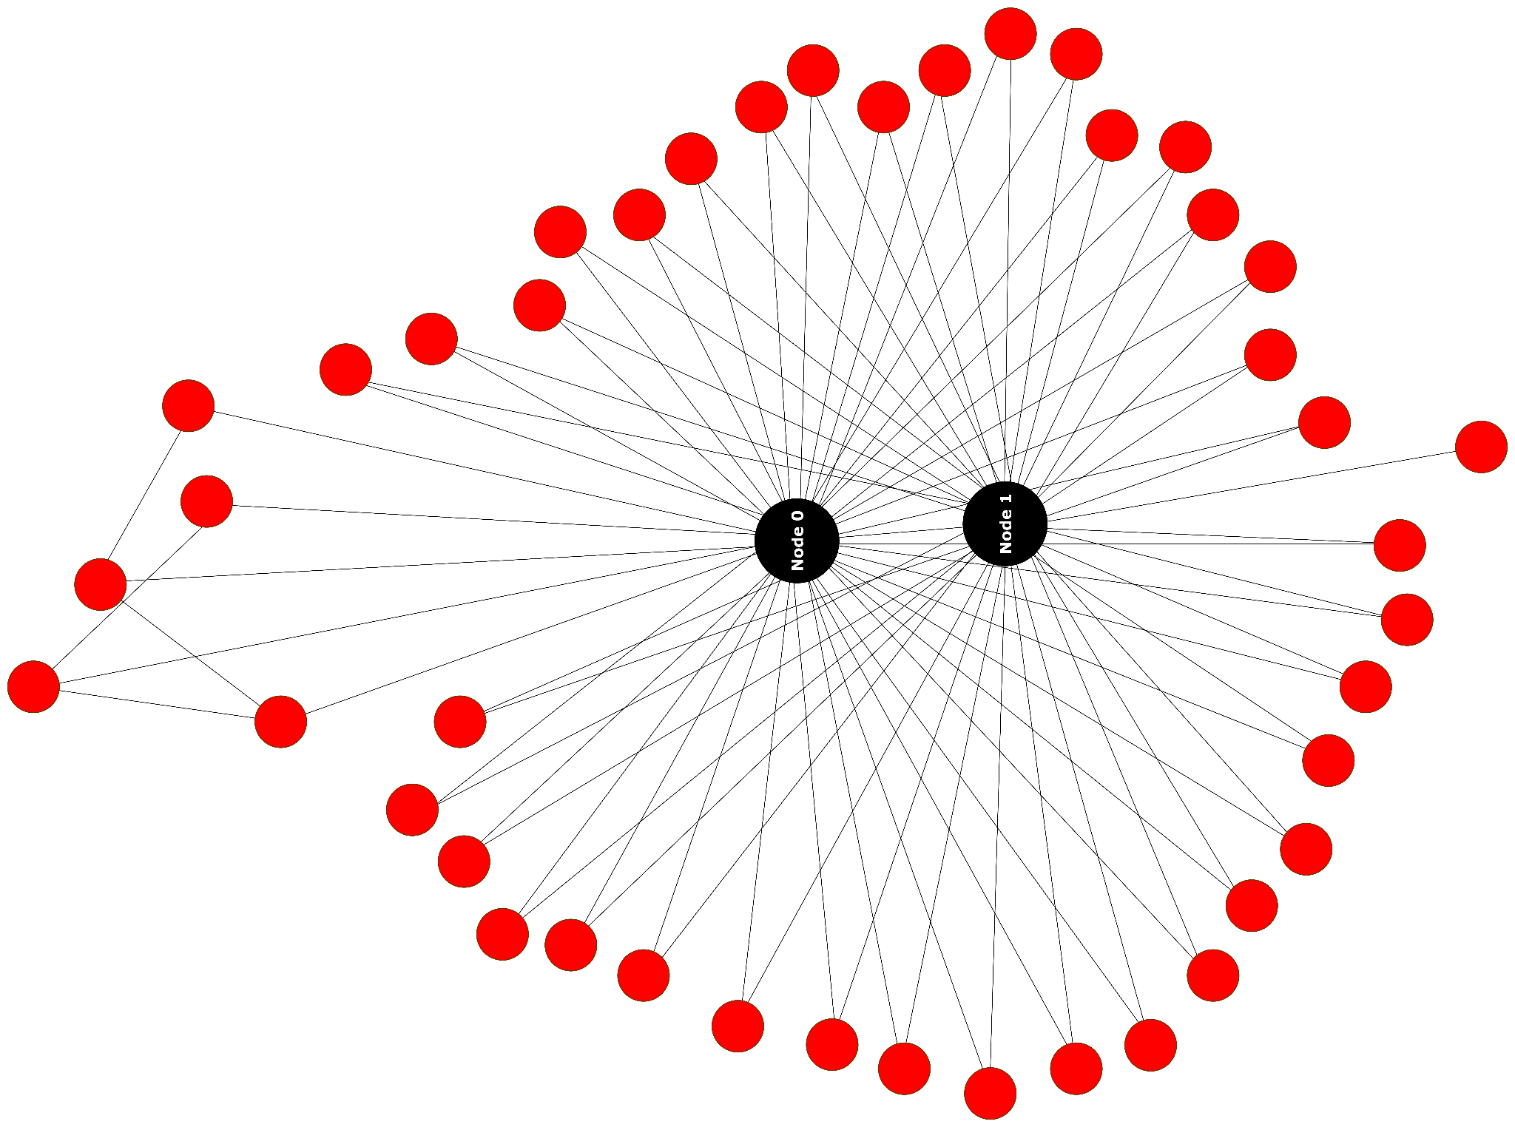
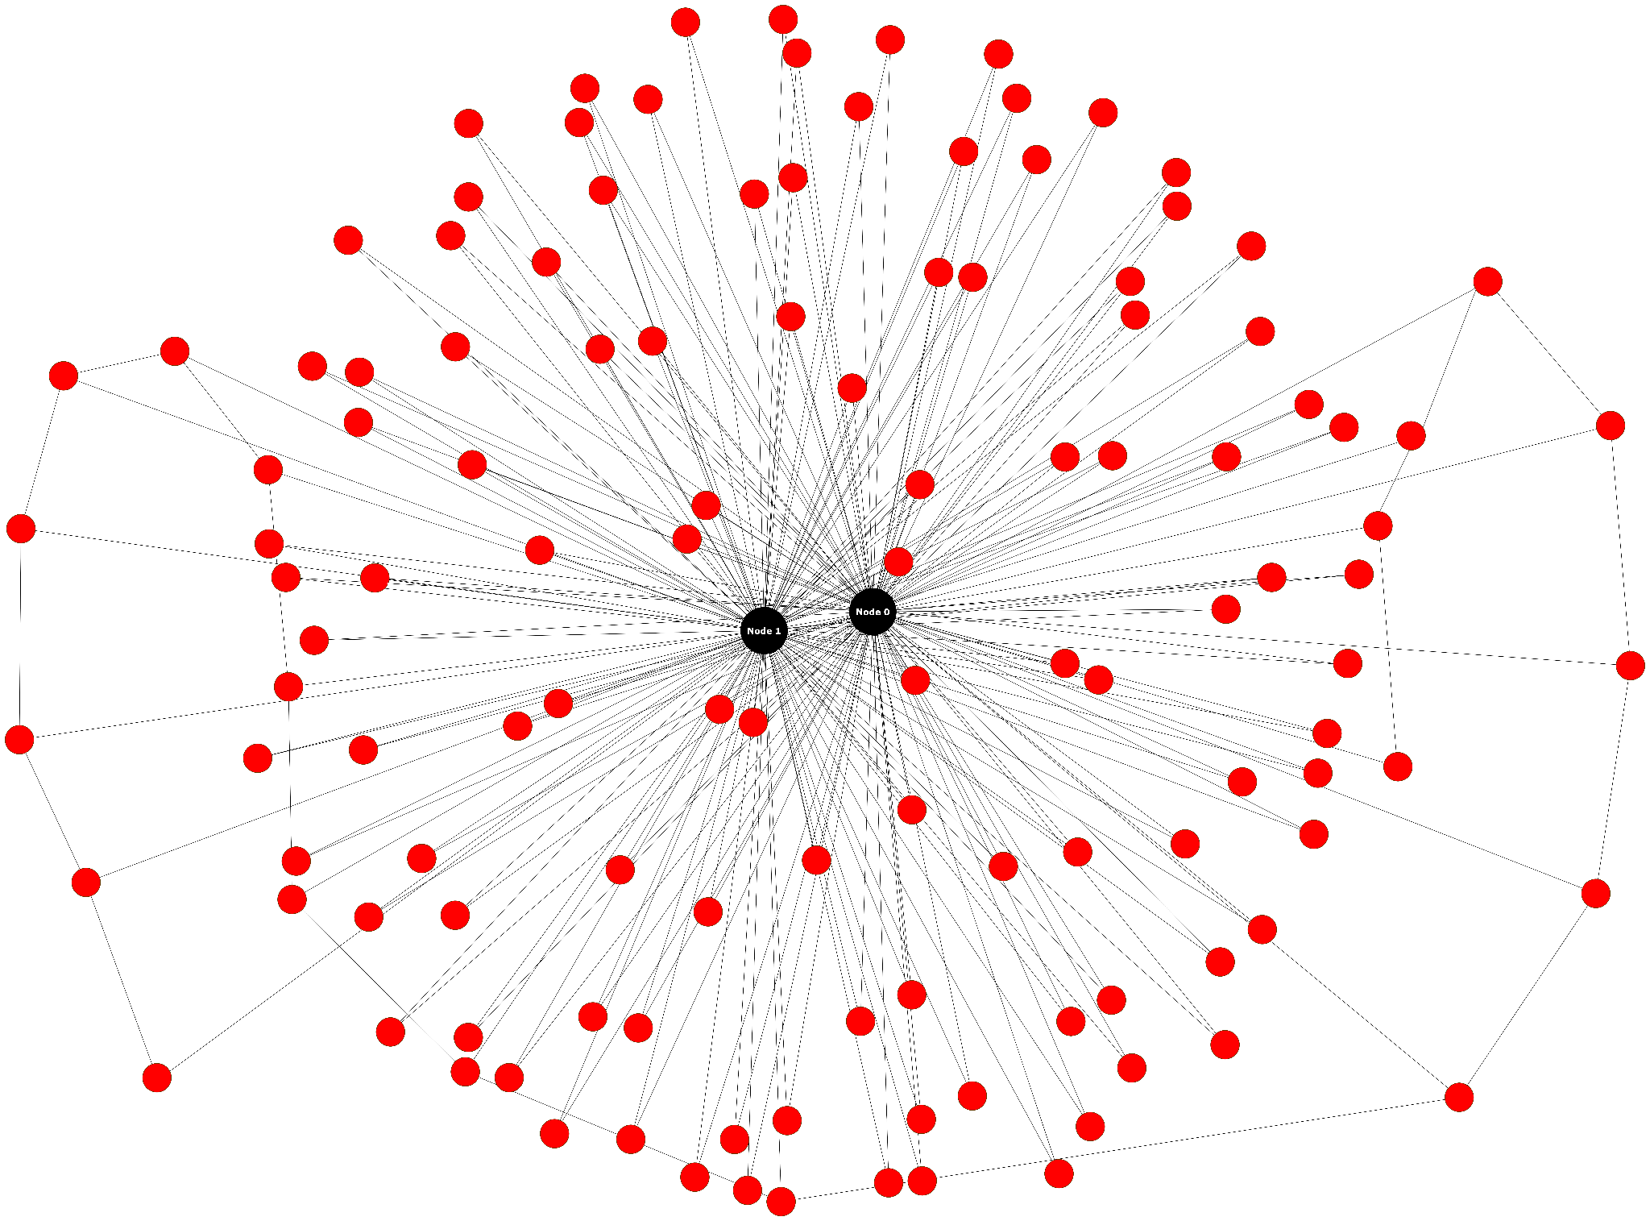
Data Sets (expanded)
L1 (45 Nodes)
L2 (125 Nodes)
RPI
17

Slide 18
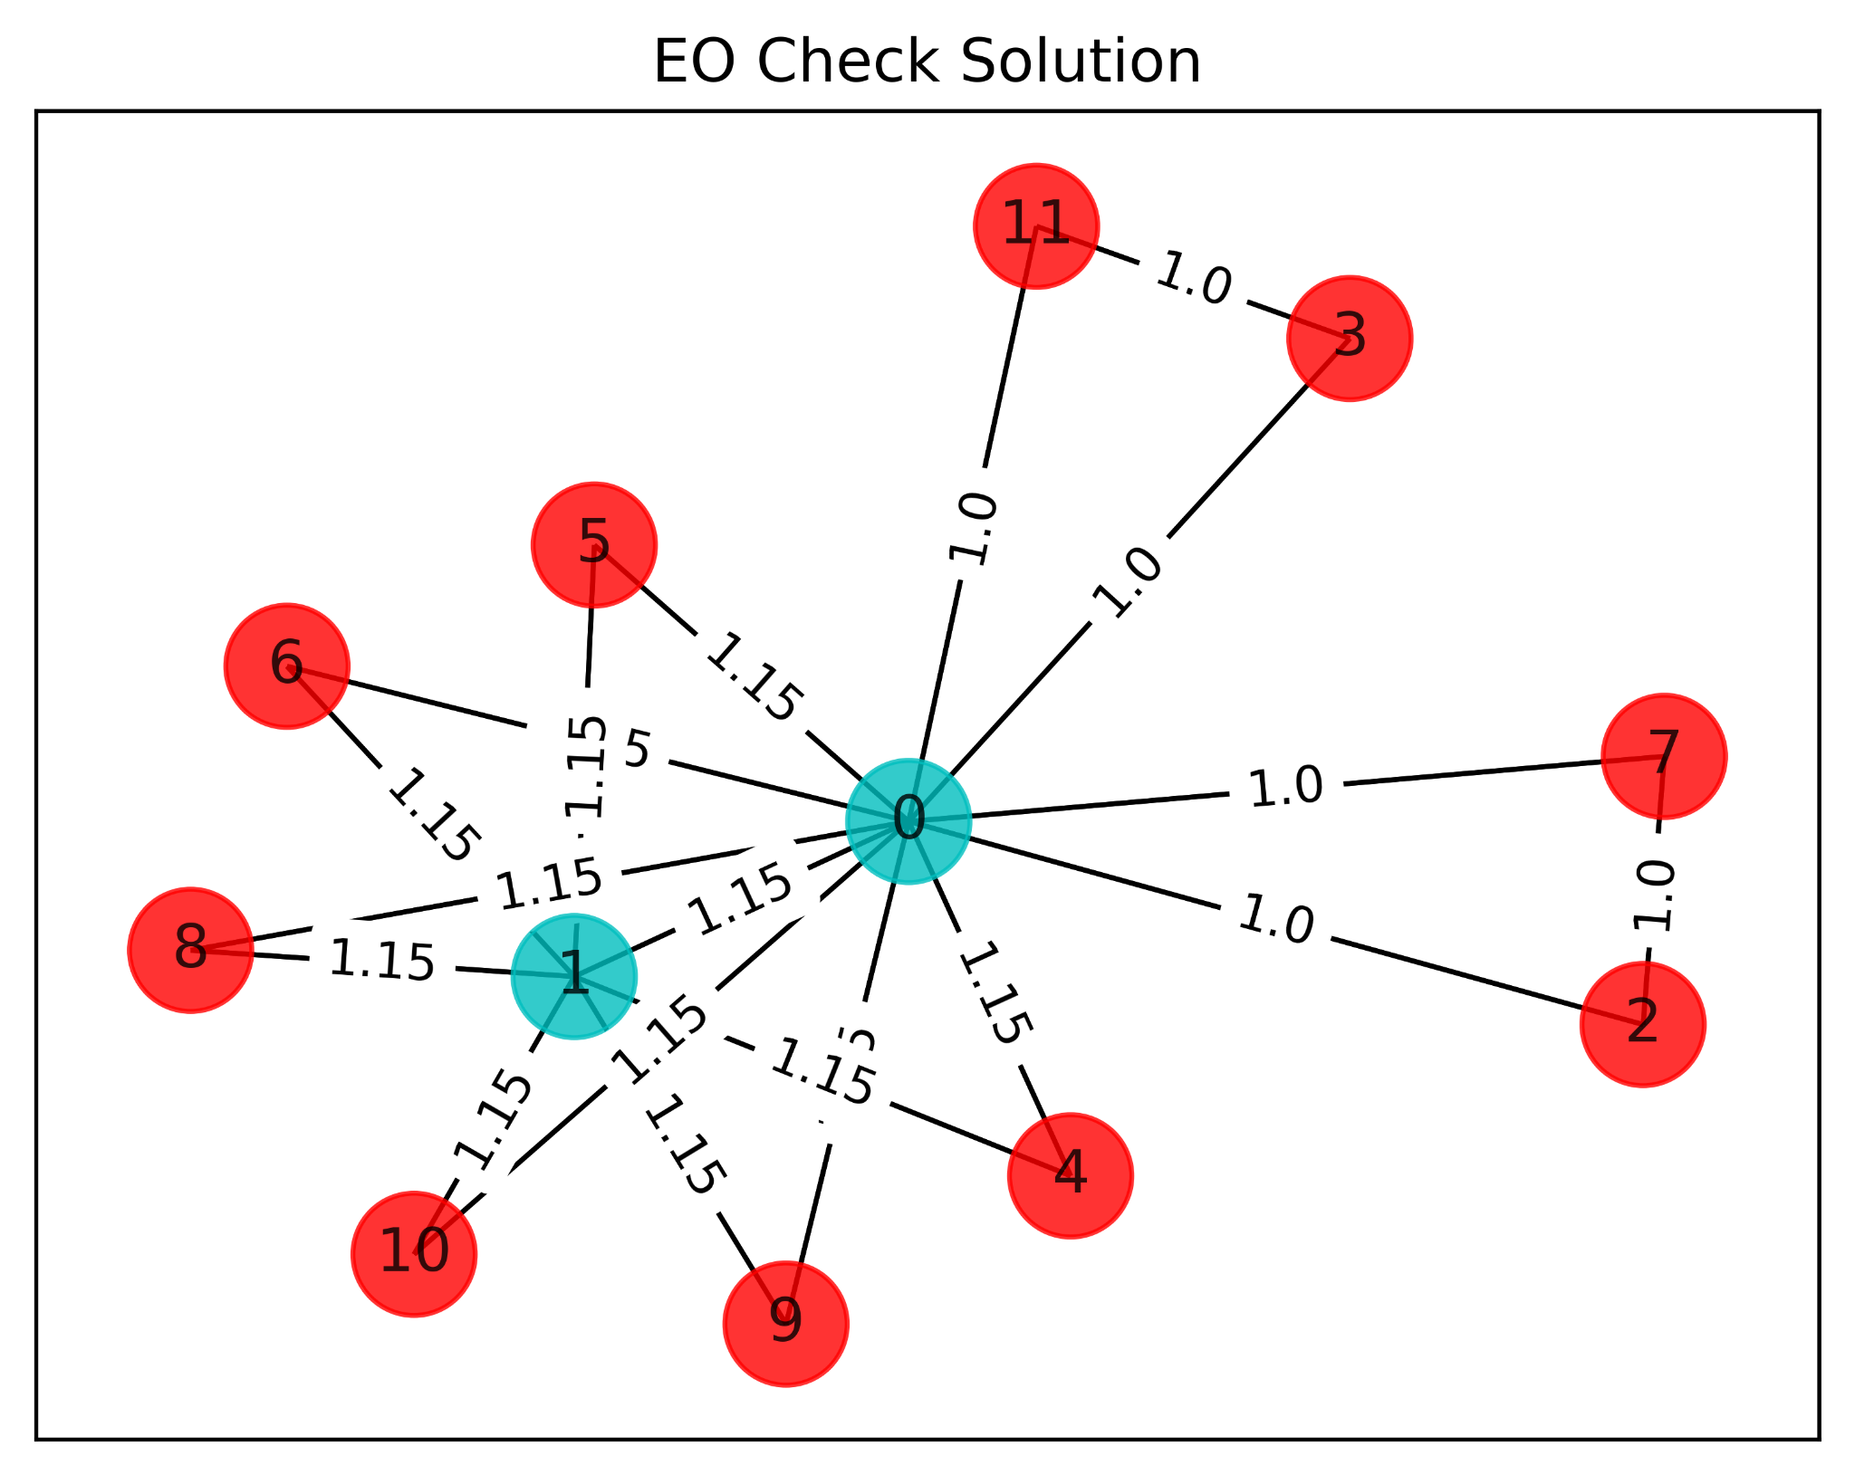
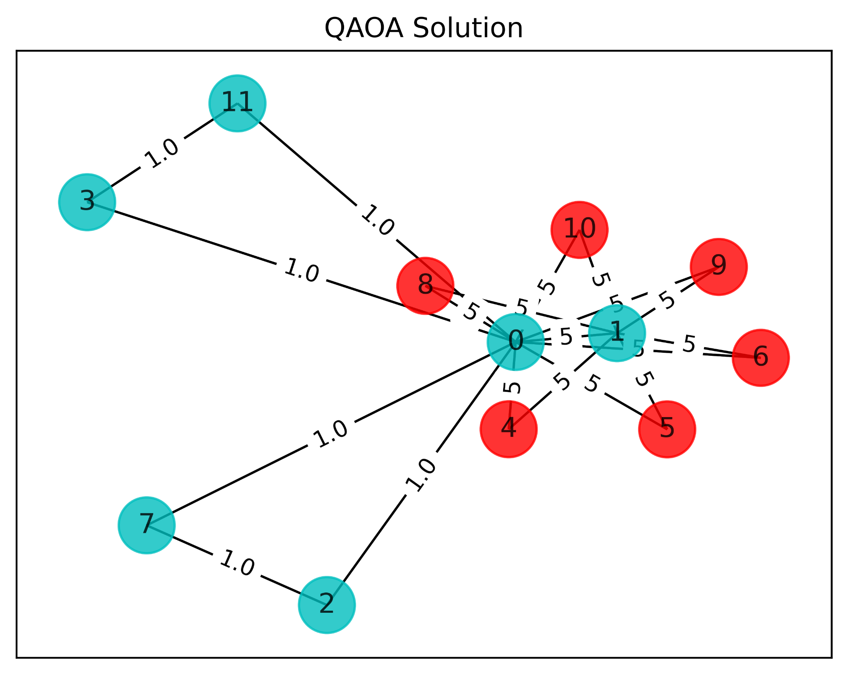
Correct Solutions vs. Ideal Solutions
RPI
Raw Solution: [1 1 0 0 0 0 0 0 0 0 0 0]
Raw Solution: [1 1 1 1 0 0 0 1 0 0 0 1]
18

Slide 19
Noiseless Simulation Results
 | QAOA |  | VQE
Set | Accuracy* | Time (s) | Accuracy* | Time (s)
P1 | 1 | 0.63 | 1 | 4.8287
P2 | 0.999 | 1.067 | 0.994 | 8.07176
P3 | 0.985 | 0.475 | 0.999 | 4.145
P4 | 0.998 | 0.603 | 0.999 | 4.968
P5 | 0.833 | 0.596 | 0.989 | 6.081
P6 | 0.622 | 0.673 | 0.799 | 5.799
RPI
* Accuracy = Amount of Correct Solutions / Total Tests Run (2000)
19
Notes:
Sets P1-6 Designate the sets within our research paper

Slide 20
Noisy Simulation Results
 | QAOA |  | VQE
Set | Accuracy* | Time (s) | Accuracy* | Time (s)
P1 | 0.9 | 185.6 | 0.9 | 350.2
P2 | 1 | 416.7 | 0.8 | 383.8
P3 | 1 | 174.9 | 1 | 343.1
P4 | 0.9 | 177.7 | 1 | 346.4
P5 | 0.4 | 175.384 | 1 | 329.924
P6 | 0.6 | 175.354 | 1 | 333.069
RPI
* Accuracy = Amount of Correct Solutions / Total Tests Run (10)
20

Slide 21
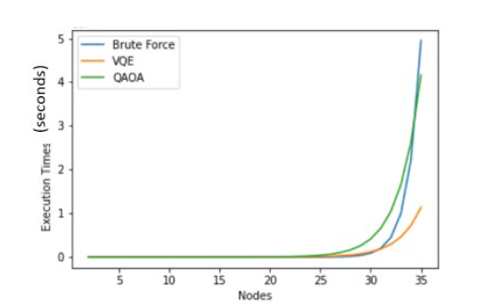
Execution Time vs Number of Nodes/Qubits
Predicts quantum advantage for more than 30-35 qubits
RPI
21
Notes:
From IEEE UEMCON 2024

Slide 22
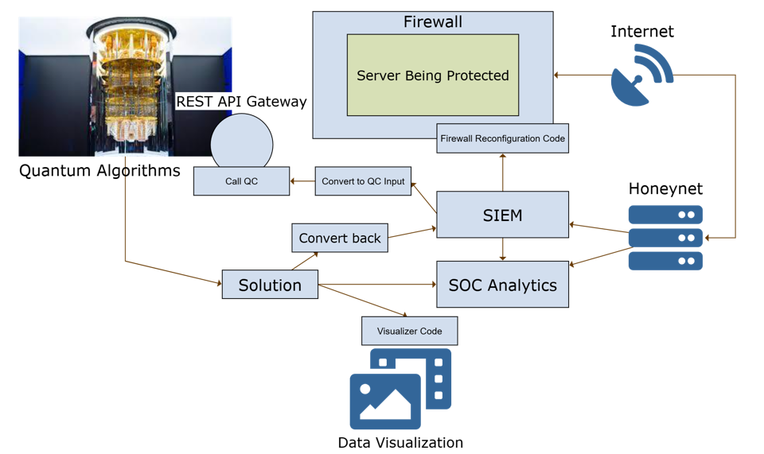

Marist Test Bed for SIEM Integration (10 qubit proof of concept)
pfSense
RPI
22
Notes:
Fall 2024 Cyber Capping Project

Slide 23
Conclusions
Reduce exponential execution time problems to polynomial execution time problems
QAOA and VQE efficiently and accurately found the solutions to the Max-Cut equations
Currently limited to 1 node per qubit, larger graphs can be attempted with more qubits
Quantum Advantage occurs somewhere around 25-30 nodes
VQE takes twice as long as QAOA
VQE is slightly more accurate
RPI
23
Notes:
Overall, through our tests on quantum computing algorithms and their ability to find the max-cut of a graph to block DoS and DDoS traffic from getting to a target, we believe that quantum computing can reduce certain exponential execution time problems to polynomial execution time problems.
VQE had a high overall accuracy, whereas QAOA had slightly
Here we used a weight of 5 for a malicious attack but that number is arbitrary and can be anything greater than 1
Although VQE takes less time than QAOA, it is less accurate when producing results
When working with data set one and using weights of 1 and 5 we found that QAOA took about 558 seconds. This amount of time is heavily dependent on the limited number of qubits. It is, however, extremely accurate and shows great potential.
VQE on the other hand took about 108 seconds but has shown to be not as accurate. However, since it is often close to the correct solution, and offers a time advantage, it may still be more helpful than VQE in certain situations.
Why is this important? (Talk about this at the beginning and end of the presentation)
In closing, quantum computing algorithms have already been used in many fields, like chemistry to simulate chemical reactions. Our research serves as a proof of concept for how quantum computing can be used in the field of cybersecurity.
Since we only had access to 8 qubits to run our tests, we could not model some cases that we might see in the real world with hundreds or thousands of DDoS attack nodes. However, as quantum computers with more qubits become more readily available, we hope that companies will leverage them in their defense strategy and use them to try to stop DoS and DDoS attacks on their systems.

Slide 24
Impact
For large networks, only quantum computers can solve the max-cut equation to mitigate the DoS/DDoS attack in a short amount of time.
We can use current data to extrapolate our results to larger networks with more than 125 nodes
We are currently in the process of re-creating the simulator test results on ibm_rennselaer, a 127 qubit machine
We are also currently in the process of implementing this program into a live server and testing it with real incoming network connections
For this we are utilizing splunk, and various firewall configuration systems and software, such as pfSense
RPI
24
Notes:
Overall, through our tests on quantum computing algorithms and their ability to find the max-cut of a graph to block DoS and DDoS traffic from getting to a target, we believe that quantum computing can reduce certain exponential execution time problems to polynomial execution time problems.
VQE had a high overall accuracy, whereas QAOA had slightly
Here we used a weight of 5 for a malicious attack but that number is arbitrary and can be anything greater than 1
Although VQE takes less time than QAOA, it is less accurate when producing results
When working with data set one and using weights of 1 and 5 we found that QAOA took about 558 seconds. This amount of time is heavily dependent on the limited number of qubits. It is, however, extremely accurate and shows great potential.
VQE on the other hand took about 108 seconds but has shown to be not as accurate. However, since it is often close to the correct solution, and offers a time advantage, it may still be more helpful than VQE in certain situations.
Why is this important? (Talk about this at the beginning and end of the presentation)
In closing, quantum computing algorithms have already been used in many fields, like chemistry to simulate chemical reactions. Our research serves as a proof of concept for how quantum computing can be used in the field of cybersecurity.
Since we only had access to 8 qubits to run our tests, we could not model some cases that we might see in the real world with hundreds or thousands of DDoS attack nodes. However, as quantum computers with more qubits become more readily available, we hope that companies will leverage them in their defense strategy and use them to try to stop DoS and DDoS attacks on their systems.

Slide 25

Thank You!
25

Slide 26
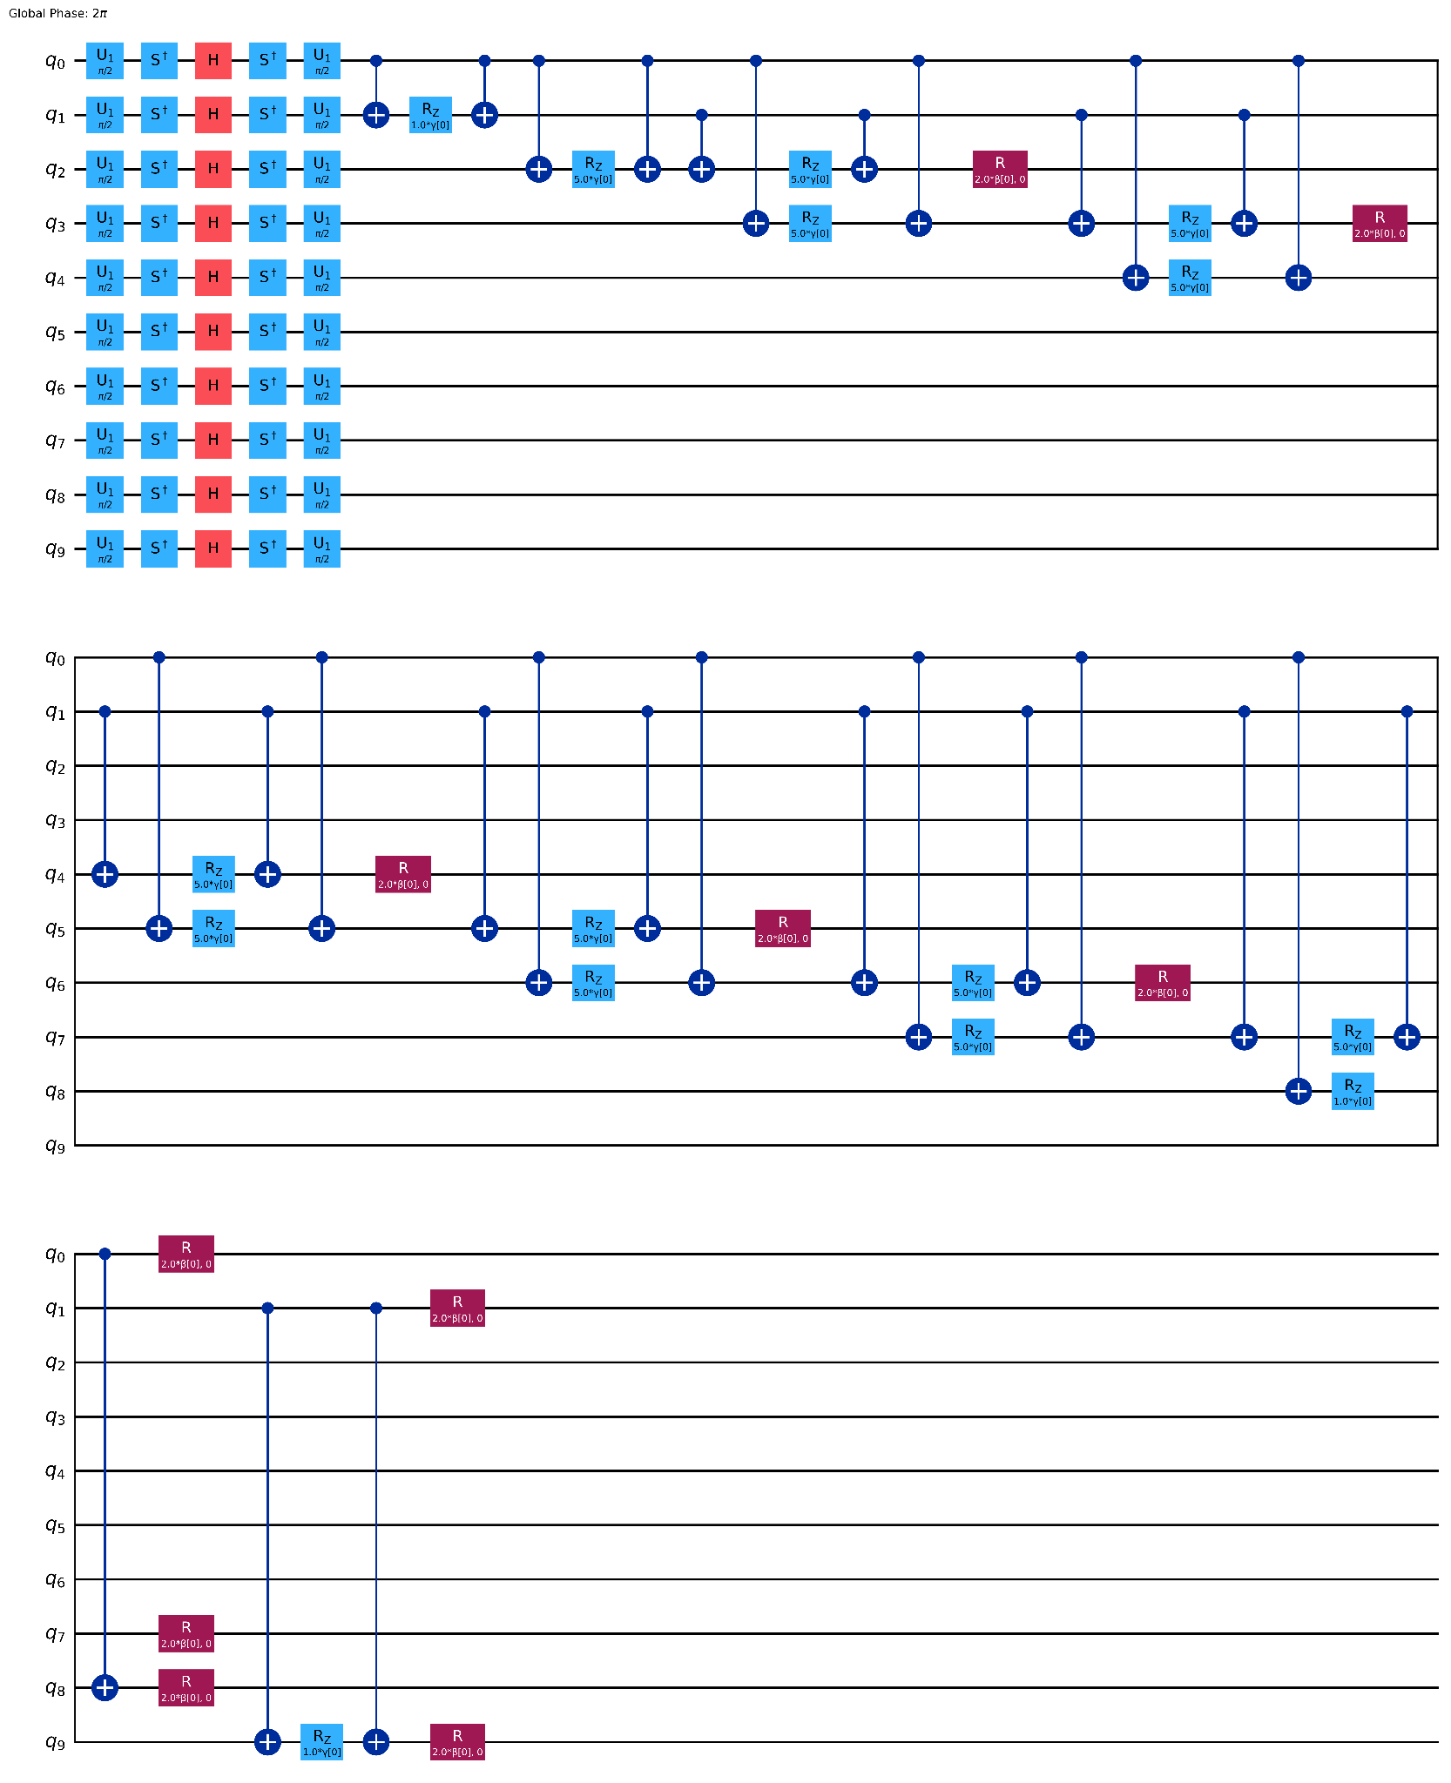
Updated P1 Circuit (QAOA)
As part of the Qiskit 1.0, circuits sent are automatically optimized in the cloud to be most efficient during runtime
Optimization at each step allows us to find the lowest energy eigenstates of the system
RPI
26
Notes:
The Quantum Approximate Optimization Algorithm (QAOA), a hybrid quantum-classical algorithm, is expected to obtain better approximate solutions than any existing classical algorithms. QAOA utilizes a classical computer trains the parameters for quantum circuit. The parameterized quantum circuit approximates the adiabatic evolution from an initial Hamiltonian, whose ground energy state is easy to prepare, to a final Hamiltonian, whose ground energy state encodes the solution of the Max-Cut problem.

Slide 27
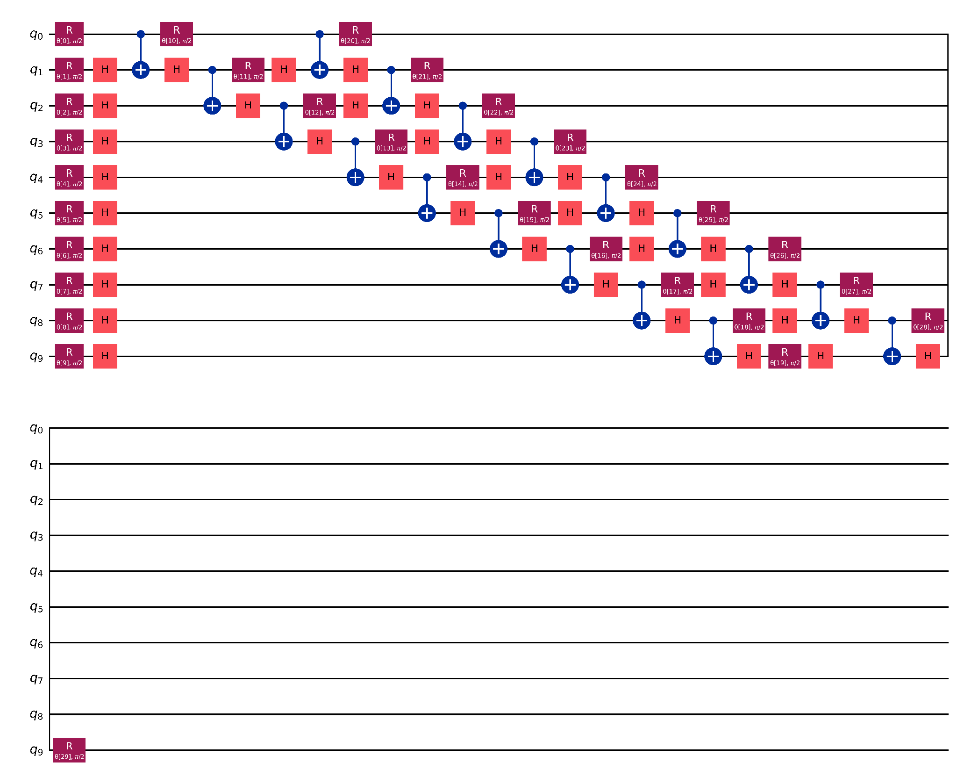
Updated P1 Circuit (VQE)
Expected to obtain better approximate solutions
Samples the circuit to approximate solutions to the optimization problem
RPI
27
Notes:
The Quantum Approximate Optimization Algorithm (QAOA), a hybrid quantum-classical algorithm, is expected to obtain better approximate solutions than any existing classical algorithms. QAOA utilizes a classical computer trains the parameters for quantum circuit. The parameterized quantum circuit approximates the adiabatic evolution from an initial Hamiltonian, whose ground energy state is easy to prepare, to a final Hamiltonian, whose ground energy state encodes the solution of the Max-Cut problem.

